Slide 1

The OpenAI API: First OpenAI API Call- Chat Completion

Slide 2
Aaron Beck
“The stronger person is not the one making the most noise but the one who can quietly direct the conversation toward defining and solving problems.”

Slide 3


Environment Review

Slide 4
Getting Our API Key
Unlock the door to ChatGPT!

Slide 5
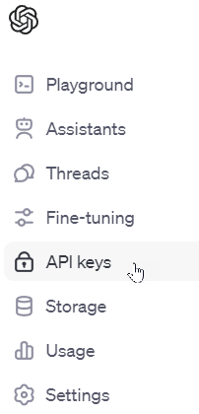
Getting the Key

Slide 6

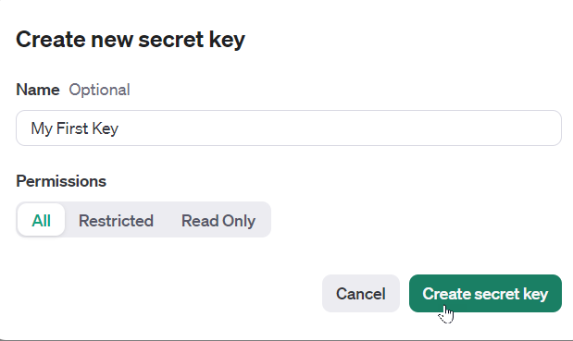
Generating a New Key

Slide 7
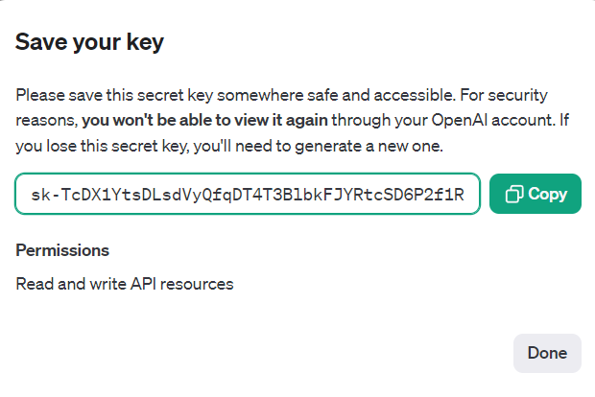
Saving the Key

Slide 8
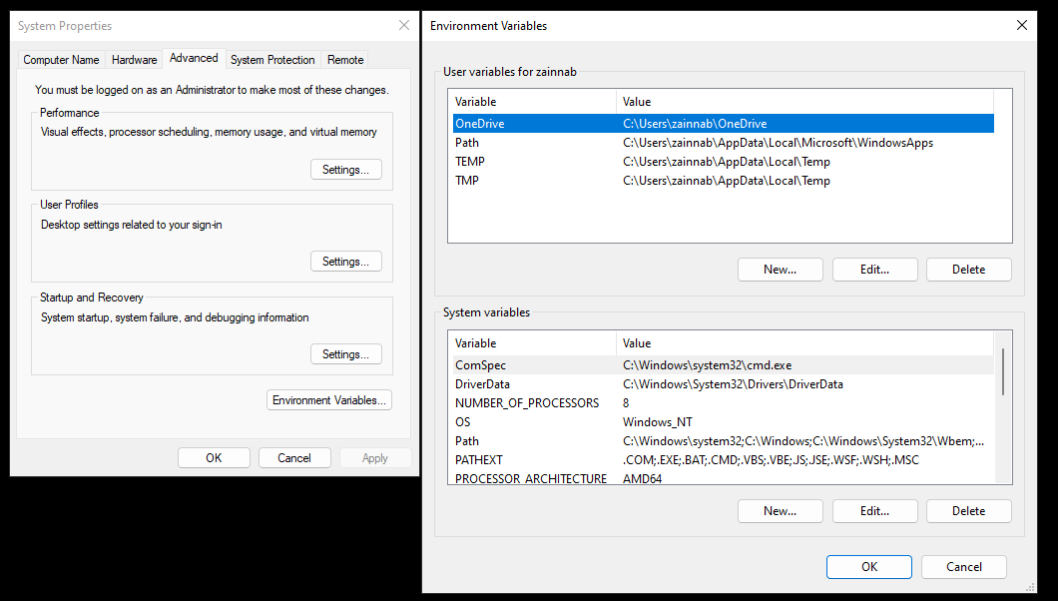

Setting Your Environment Variable
Notes:
OPENAI_API_KEY

Slide 9
Let’s Write Some Code!
Our First Call to the API

Slide 10
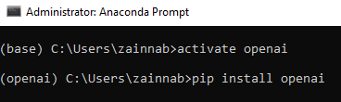
Installing the OpenAI Python Library
Notes:
pip install openai

Slide 11
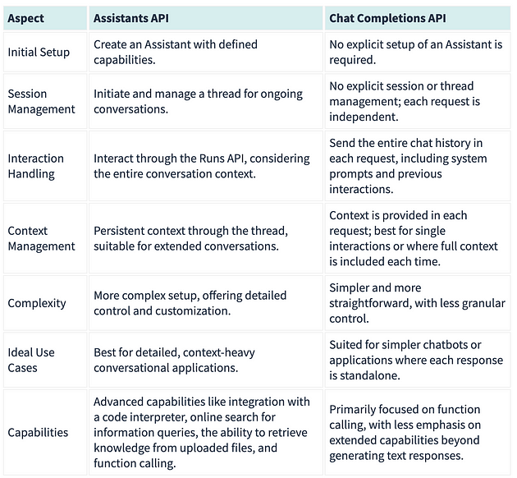
Assistants API vs Chat Completion API
Notes:
https://medium.com/leniolabs/exploring-openais-apis-assistants-vs-chat-completions-91525f73422c
https://platform.openai.com/docs/models/model-endpoint-compatibility

Slide 12
The “Easy” Way
from openai import OpenAI
client = OpenAI()
completion = client.chat.completions.create(
model="gpt-4-turbo-preview",
messages=[
{"role": "system", "content": "You are an expert in penguins."},
{"role": "user", "content": "Give me a list of 10 species of penguins in the world. Just give me the list and nothing else."}
]
)
print(completion.choices[0].message)
Notes:
from openai import OpenAI
client = OpenAI()
completion = client.chat.completions.create(
model="gpt-4-turbo-preview",
messages=[
{"role": "system", "content": "You are an expert in penguins."},
{"role": "user", "content": "Give me a list of 10 species of penguins in the world. Just give me the list and nothing else."}
]
)
print(completion.choices[0].message)
# Just get the content of the message
print(completion.choices[0].message.content)

Slide 13
The “Hard” Way
import requests
import json
import os
# Fetch the API key from environment variables
api_key = os.getenv('OPENAI_API_KEY')
# Define the headers
headers = {
'Authorization': f'Bearer {api_key}',
'Content-Type': 'application/json',
}
# Chat Completions request data
data = {
'model': 'gpt-4-turbo-preview',
'messages': [
{'role': 'system', 'content': "You are an expert in penguins."},
{'role': 'user', 'content': "Give me a list of 10 species of penguins in the world. Just give me the list and nothing else."}
]
}
response = requests.post('https://api.openai.com/v1/chat/completions', headers=headers, data=json.dumps(data))
print(response.json())
Notes:
import requests
import json
import os
# Fetch the API key from environment variables
api_key = os.getenv('OPENAI_API_KEY')
# Define the headers
headers = {
'Authorization': f'Bearer {api_key}',
'Content-Type': 'application/json’,
}
# Chat Completions request data
data = {
'model': 'gpt-4-turbo-preview',
'messages': [
{'role': 'system', 'content': "You are an expert in penguins."},
{'role': 'user', 'content': "Give me a list of 10 species of penguins in the world. Just give me the list and nothing else."}
]
}
response = requests.post('https://api.openai.com/v1/chat/completions', headers=headers, data=json.dumps(data))
print(response.json())
# Assuming 'response' is our variable that holds the JSON response from the API
response_data = response.json()
# Extracting the list of penguins from the response
penguin_list = response_data['choices'][0]['message']['content']
print(penguin_list)

Slide 14


